Slide 1
Impact of Remote Work on Mental Health
Regis University - MSDS696 - Data Science Practicum I
Instructor: John Koenig ABHILASH REDDY GitHub/Project Link: https://github.com/Areddyp/Final-Project
Notes:
"Hello everyone, my name is Abhilash, and this is my practicum project on ‘The Impact of Remote Work on Mental Health’. In this project, I developed a machine learning-based analytical tool which runs on custom trained machine and deep learning models to identify mental health risk levels for remote workers, using a custom-built Streamlit app."

Slide 2
Project overview
Understand mental health impacts of remote work
Use machine learning to predict mental health risks
Build an interactive Streamlit tool for predictions
Translate insights into accessible information for users
Notes:
The goal of this project is to understand how different remote work conditions may contribute to mental health risks. Using a combination of machine learning and data visualization, I developed a tool to help individuals and organizations assess risk indicators. The final product is an accessible, interactive web app powered by Streamlit.

Slide 3
problem
Post-COVID Work Culture Shift & Mental Health Crisis
The pandemic led to a dramatic shift to remote work.
Studies show increased stress, isolation, and burnout among remote workers.
HR managers struggle to proactively identify mental health issues.
Key Articles Highlighting the Problem:
Forbes: “Remote Work Burnout is Real”
Harvard Business Review: “The Dark Side of Remote Work”
McKinsey: “Mental Health in the Workplace”

Slide 4
Data description
Dataset:
Source: Kaggle – Remote Work and Mental Health
Format: Tabular CSV
Number of records: ~1000+ employee responses
Type: Survey data collected post-COVID from remote/hybrid/onsite employees
Notes:
The dataset used in this project part of Kaggle community includes survey responses covering demographic details and remote work-related mental health factors. Features like age, gender, and support systems were crucial for modeling. After cleaning and preprocessing, the dataset was ready for analysis and model training.

Slide 5
EDA and key insights
Positive correlation between poor company support and mental health issues
Flexible work hours linked with reduced mental health risks
Family history of mental health plays a significant role
Feature Engineering:
Converted categorical variables like Gender, Family_History, Work_Environment_Satisfaction into numerical form using Label Encoding
Created new binary columns for Yes/No responses to capture stress-related conditions
Normalized continuous features such as Age for consistent model input
Target variable Stress_Level derived and encoded as ordinal values representing risk levels (Low, Medium, High)
Visualization tools: Seaborn and Matplotlib
Notes:
During the exploratory data analysis phase, I uncovered important trends. Employees without support from their companies had a higher incidence of mental health issues. Flexibility in working hours also correlated with better mental wellbeing. Visual tools like Seaborn and Matplotlib were instrumental in identifying these patterns. Additionally, I engineered features from categorical and ordinal variables to enhance model training and interpretability. The target variable, Stress_Level, was mapped to represent increasing levels of mental health risk.

Slide 6

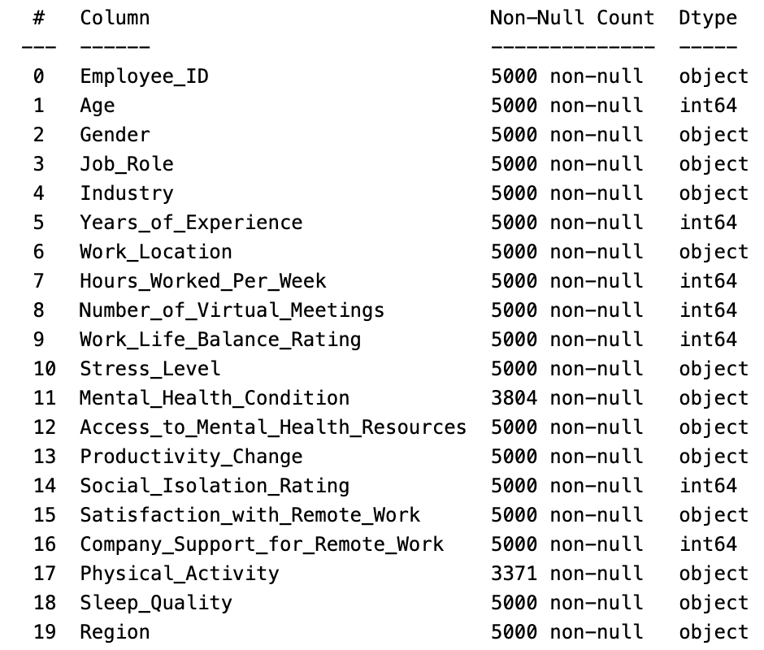
EDA and key insights - features
Notes:
This slide explains the multiple features in data along with type of the data and missing data information

Slide 7
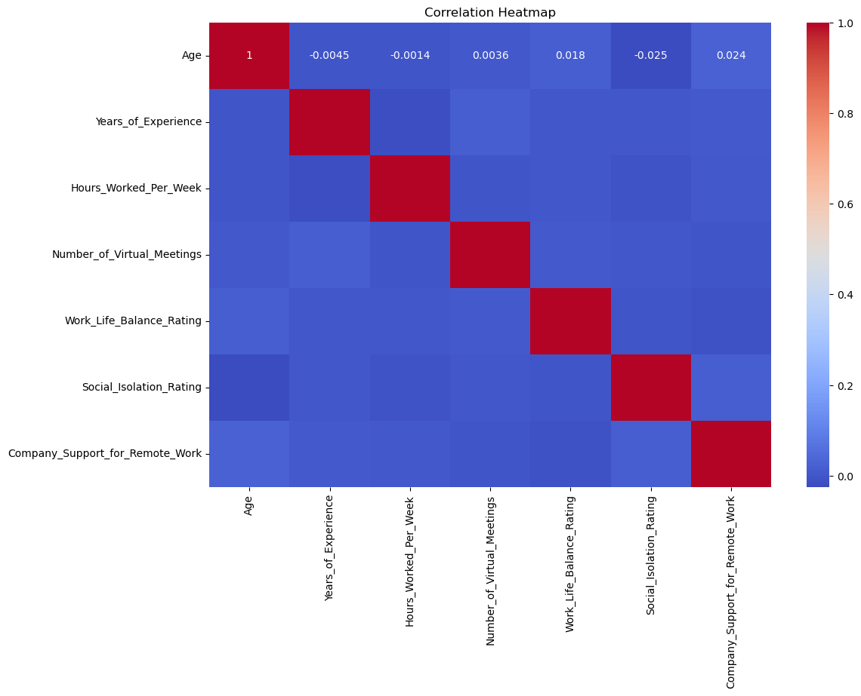
EDA and key insights - Correlation Heatmap (Numerical Variables)
Notes:
This is the correlation heatmap of the main numerical features in the dataset. Each square shows the strength and direction of the relationship between two variables. For example, age and years of experience have almost no correlation here, and we can see the same trend across most other feature pairs. Since the dataset is synthetically generated, we don’t observe strong natural correlations, which is expected. However, this step helped ensure there were no highly correlated features that could introduce redundancy or bias into the model. It also confirmed that our features are mostly independent, which is ideal for many machine learning algorithms.

Slide 8
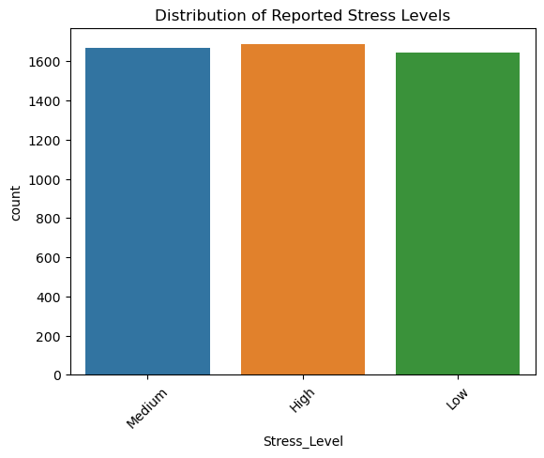
EDA and key insights – TARGET VARIABLE Distribution
Notes:
This bar plot shows the distribution of the target variable: stress levels. The stress levels are divided into three classes — low, medium, and high — and the counts are quite balanced across all three. Medium and high stress levels are slightly more frequent than low stress. This balanced distribution is important because it means the model won’t be biased toward any one class. It also allowed us to use standard accuracy and F1-score metrics without needing special balancing techniques. Overall, it confirmed that the dataset was suitable for a multi-class classification task.

Slide 9
Note: About the Dataset
The dataset used is synthetically generated
It does not exhibit a naturally occurring distribution or correlation between the variables
Trends captured by the models are representative rather than predictive of real-world behavior
Despite this, the data serves well for research and prototyping purposes
Notes:
It is important to highlight that the dataset used in this project is synthetically generated. As such, it may not represent actual population distributions, and the model’s ability to generalize is limited. However, for the purposes of learning, research, and demonstrating tool functionality, this dataset was sufficient and enabled the development of a working end-to-end solution.

Slide 10
Model development
Models tried: Logistic Regression, Support Vector Machines, Random Forest, LightGBM, Custom Neural Network architecture
Metrics used: Accuracy, Precision, Recall, F1 Score
Best performer: LightGBM with balanced precision and recall
Interpretation: Feature importance plots used for explainability
Neural Network Architecture:
Input layer: 128 neurons with ReLU activation
Dropout: 30% to prevent overfitting
Hidden layer: 64 neurons with ReLU
Dropout: 30% again
Output layer: softmax activation for classification
Notes:
I evaluated several classification models to predict the likelihood of mental health concerns. In addition to traditional models, I also experimented with a custom neural network. The architecture consists of an input layer with 128 neurons using ReLU activation, followed by a 30% dropout layer to reduce overfitting. This is followed by a hidden layer of 64 neurons, another dropout layer, and finally, an output layer using softmax for classification. While this model offered decent results, it was slightly outperformed by LightGBM in terms of generalization and interpretability for this particular dataset. Feature importance graphs helped break down what influenced each prediction.

Slide 11
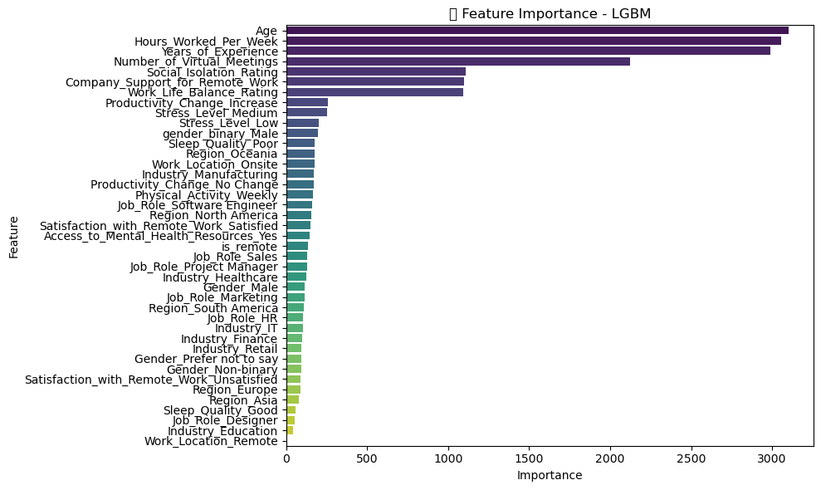
Model development – Feature importance LightGBM
Notes:
LightGBM emerged as the best performer, offering high accuracy and interpretability. The feature importance plot shown here ranks input variables based on their impact on the model’s predictions. As seen in the plot, the top contributors are Age, Hours Worked Per Week, and Years of Experience. These are followed by variables like the Number of Virtual Meetings, Social Isolation Rating, and Company Support for Remote Work. This suggests that workload and workplace support systems are strong indicators of stress levels in remote environments. Less impactful features such as job roles, industry, or region reflect the synthetic nature of the dataset, but still help simulate diverse scenarios for tool demonstration.

Slide 12
Streamlit app features
Upload user data or use demo inputs
Live prediction based on trained model
Display of model confidence and influencing factors
Clean interface for non-technical users
Notes:
The project culminated in an easy-to-use Streamlit web application. Users can upload their data or use sample entries to see mental health risk predictions in real-time. The app not only displays the outcome but also shows what factors led to the prediction.

Slide 13

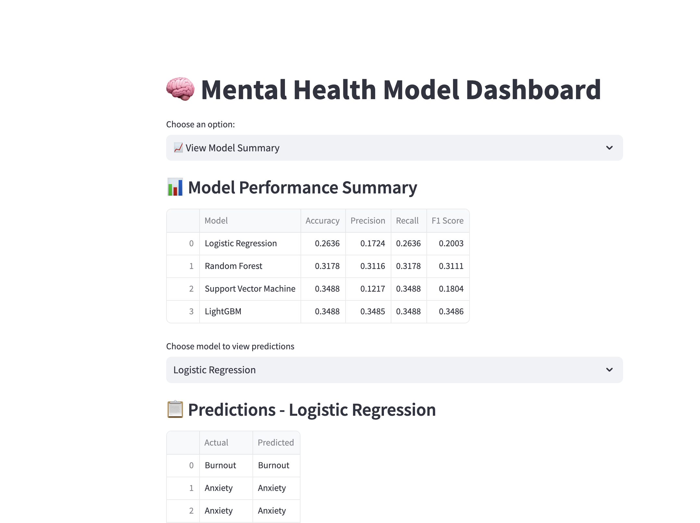
UI view - homepage
Notes:
This is the home page of the tool highlighting the metrics of the multiple models trained and sample predictions on the test data for those multiple models

Slide 14
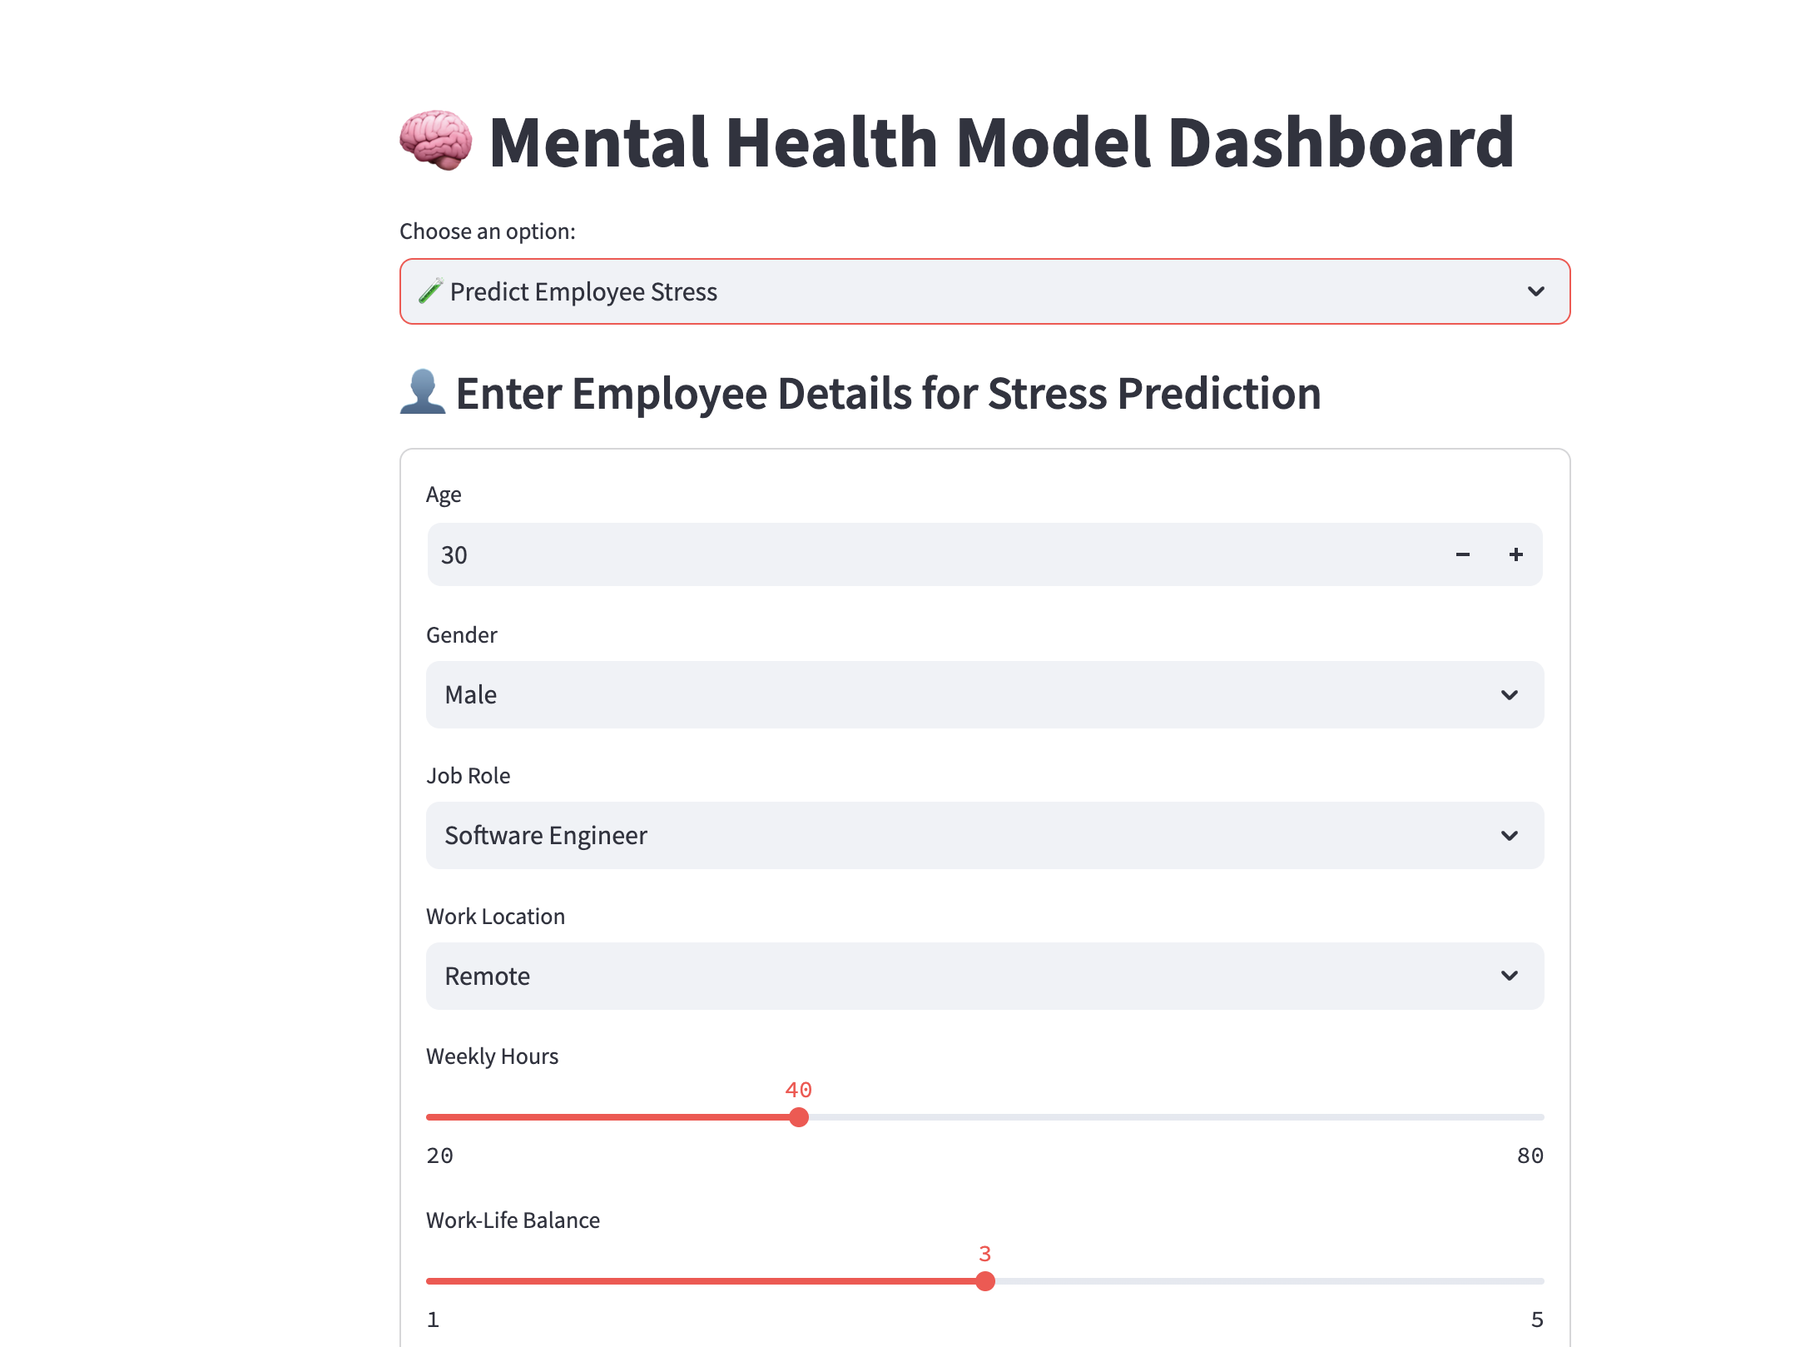
UI view – predict employee stress - 1
Notes:
This slide displays the input interface of the application. To get a prediction, users enter several personal and work-related details. These include age, gender, job role, and work location. Two sliders allow dynamic input of weekly working hours and self-rated work-life balance. The interface has been carefully designed for clarity and ease of use, ensuring that users of any background can navigate the form and receive a prediction without confusion. This helps reinforce accessibility and user engagement for the tool.

Slide 15
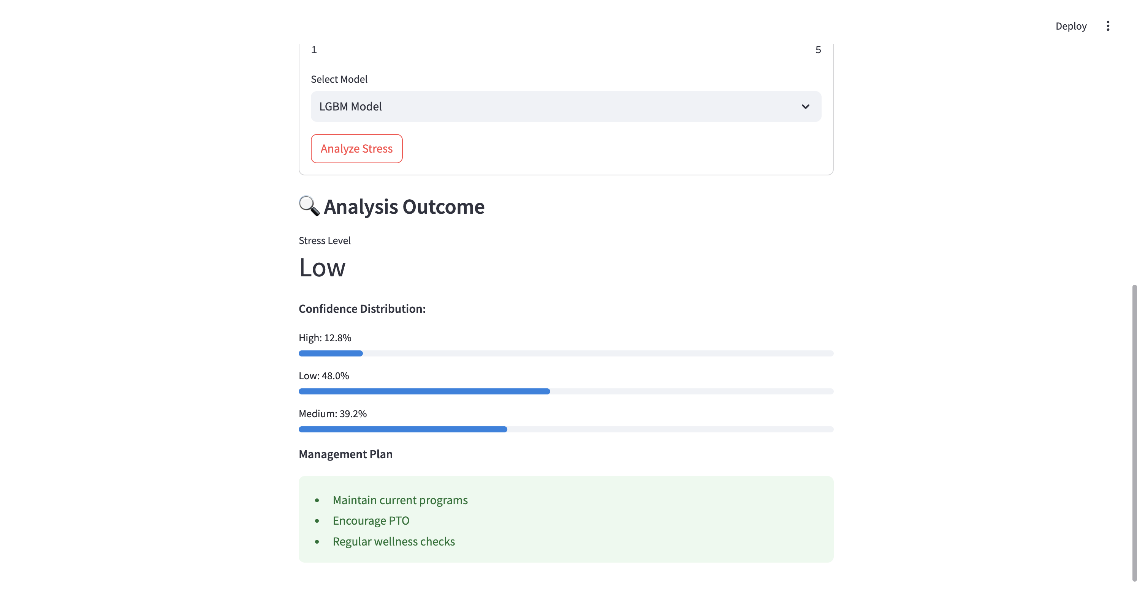
UI view – predict employee stress - 2
Notes:
Model selected: LightGBM
Prediction: Stress Level = Low
Confidence scores: Low – 48.0%, Medium – 39.2%, High – 12.8%
Recommendation Plan:
Maintain current programs
Encourage PTO (Paid Time Off)
Conduct regular wellness checks
This slide illustrates a sample output from the Streamlit app. The user selects a model—here, the LightGBM model—and clicks ‘Analyze Stress’. The app predicts a 'Low' stress level, with confidence scores across all three classes displayed clearly. Along with this result, the app also generates a management plan tailored to the risk level, suggesting actionable steps like maintaining wellness programs and encouraging PTO. This design helps turn predictive insights into practical recommendations for individuals or HR teams.

Slide 16
Challenges faced
At first, I depended too much on AI tools without fully understanding the logic.
It was hard to choose features and models that really made sense for the problem.
Making the Streamlit app user-friendly took time and many improvements.
The dataset was synthetic, so finding real patterns was tricky.
I had to make sure my tool was easy to use for non-technical people.
Notes:
One of the first challenges I faced was depending too much on AI tools like ChatGPT to help with code. While they were useful for getting started, I realized I wasn’t understanding the logic behind the code deeply enough. This made my early progress feel superficial, and I had to take a step back to really study the dataset and define the problem clearly.
Another major challenge was in feature engineering. I tried multiple methods such as label encoding for categorical variables, one-hot encoding for features like gender and work location, and scaling techniques where needed. I had to experiment with which features made the most sense and which ones were confusing the model.
I also tested various machine learning models before finalizing the best ones. These included Logistic Regression, Random Forest, LightGBM, and a custom-built Neural Network using TensorFlow. Each model had its pros and cons. For example, LightGBM gave good accuracy and interpretability, while the neural network needed more tuning to perform well.
Making the Streamlit app user-friendly was another learning curve. At first, it was just a basic UI, but I had to rework it several times to improve clarity, add slider inputs, better prediction outputs, and a clear management plan section.
Lastly, since the dataset was synthetically generated, it didn’t have natural trends like real-world data. This made pattern recognition and model training more difficult. But for research and tool design purposes, it still allowed me to test ideas and develop a complete end-to-end solution.

Slide 17
learnings
I learned how to build a full machine learning project from start to end.
I used Streamlit to turn my code into a working app anyone can try.
I got better at understanding how data and mental health are related.
I now see the importance of using AI carefully, especially for topics about people’s lives.
Notes:
This project helped me grow both technically and personally. First, I learned how to take a machine learning problem from start to finish — including data understanding, cleaning, feature engineering, model training, evaluation, and deploying the results into a working tool.
I tried multiple models like Logistic Regression, Random Forest, LightGBM, and a custom Neural Network built using TensorFlow. I compared their performance and chose LightGBM as the final model based on its accuracy, speed, and how easily I could explain its results using feature importance plots.
On the feature engineering side, I applied label encoding, one-hot encoding, and transformation of features like 'Work-Life Balance' and 'Sleep Quality' into meaningful numerical values. I also had to deal with imbalanced class labels for the stress levels, which required testing different data splitting techniques to make sure the models weren’t biased.
I also learned how to use Streamlit to create an app that’s clean and simple for users. I made sure the tool could take inputs from users, generate predictions, and even give suggestions based on the predicted stress level.
Beyond the technical part, I understood how remote work can affect mental health — especially how factors like long hours, lack of support, or poor work-life balance can increase stress.
Most importantly, I realized the need for responsibility while using AI. Just because we can predict something doesn’t mean it’s always right or enough. We must always consider the human side when working on problems related to mental health or personal wellbeing. Technology should support empathy, not replace it.

Slide 18
Conclusion and future work
Tool successfully predicts mental health risk using user inputs
Adds value by presenting results visually and interactively
Can be extended to include time-series tracking or broader datasets
Future scope: Add feedback loop or mental health resource links

Slide 19
Thank you!

